Slide 1
Investigating the effects of fecal microbial transplantation (FMT) in both a murine model and in human patients suffering from IBD
Hôpital Saint-Antoine (AP-HP)
Harry Sokol, MD, PhD
HSAE-01-24MD+
May 29, 2025
Brian Ingram, PhD

Slide 2
Study Overview
Study Objective
The goal of this study was to investigate the effects of FMT in germ free mice and the effects of FMT (from healthy human donors) on IBD patients.
Study Design
Metabolon received 32 mouse plasma, 32 mouse cecum contents, 33 human plasma and 31 human feces samples on April 9th, 2025. Global metabolic profiles were determined from the experimental groups outlined in the tables on the following slides.

Slide 3
Study Overview (Mouse Arm)
Matrix (1): Mouse plasma
Group | Description | N
GF_FMT_Aged | Serum samples from germ free Mice who received FMT from “old” mice | 8
GF_FMT_Young | Serum samples from germ free Mice who received FMT from “young” mice | 8
Aged | Serum samples from “old” mice | 8
Young | Serum samples from “young” mice | 8
Matrix (2): Mouse cecum contents
Group | Description | N
GF_FMT_Aged | Coecum samples from Mice who received FMT from “old” mice | 8
GF_FMT_Young | Coecum samples from Mice who received FMT from “young” mice | 8
Aged | Coecum samples from “old” mice | 8
Young | Coecum samples from “young” mice | 8

Slide 4
Study Overview (Human Arm)
Matrix (3): Human plasma
Group | Description | N
Pre_FMT | Serum samples from patients before FMT | 11
Post_FMT | Serum samples from patients after FMT | 11
Healthy | Serum samples from healthy human controls | 11
Matrix (4): Human feces*
Group | Description | N
Pre_FMT | Fecal samples from patients with C difficile infection before FMT from healthy human donors. (N.B. treated with EtOH.) | 10
Post_FMT | Fecal samples from patients with C difficile infection 10 weeks after FMT from healthy human donors. (N.B. treated with EtOH.) | 11
Healthy | Fecal samples from healthy human donors used for FMT. (N.B. snap-frozen.) | 10
* It is noted that 21 of human stool samples were collected in 95% ethanol, specifically those from the “Pre_FMT” and “Post_FMT” groups. Fecal samples from the remaining 10 “healthy” subjects were provided as fresh frozen samples. All samples were dried and processed on an equivalent dry weight basis.

Slide 5
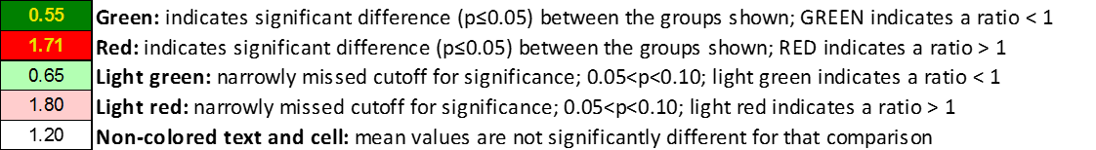
Statistical Analyses
Matched Pairs t-test and Welch’s two sample t-test were used to determine whether the means of two populations were different
p-value: evidence that the means are different (smaller is better)
q-value: estimate of the false discovery rate (smaller is better)
p ≤ 0.05 was taken as significant
Sample Statistics Table
The full table is supplied as a separate excel file

Slide 6
Statistical Summary – Mouse Study Arm
Statistical Comparisons - Mouse Plasma
Welch's Two-Sample t-Test | Aged | GF_FMT_Aged | GF_FMT_Aged | GF_FMT_Young | GF_FMT_Aged | GF_FMT_Young
 | Young | GF_FMT_Young | Aged | Young | Young | Aged
Total biochemicals p≤0.05 | 485 | 207 | 549 | 438 | 357 | 563
Biochemicals (↑↓) | 89 | 396 | 137 | 70 | 430 | 119 | 222 | 216 | 201 | 156 | 454 | 109
Total biochemicals 0.05<p<0.10 | 112 | 75 | 90 | 76 | 87 | 96
Biochemicals (↑↓) | 24 | 88 | 32 | 43 | 63 | 27 | 39 | 37 | 40 | 47 | 67 | 29
Statistical Comparisons - Mouse Cecal
Welch's Two-Sample t-Test | Aged | GF_FMT_Aged | GF_FMT_Aged | GF_FMT_Young | GF_FMT_Aged | GF_FMT_Young
 | Young | GF_FMT_Young | Aged | Young | Young | Aged
Total biochemicals p≤0.05 | 247 | 173 | 590 | 528 | 705 | 418
Biochemicals (↑↓) | 114 | 133 | 108 | 65 | 396 | 194 | 331 | 197 | 477 | 228 | 262 | 156
Total biochemicals 0.05<p<0.10 | 113 | 133 | 137 | 120 | 151 | 121
Biochemicals (↑↓) | 73 | 40 | 87 | 46 | 96 | 41 | 71 | 49 | 110 | 41 | 66 | 55

Slide 7
Statistical Summary – Human Plasma
Statistical Comparisons - Human Plasma (Volume Normalization)
Matched Pairs t-Test | After_FMT
 | Before_FMT
Total biochemicals p≤0.05 | 363
Biochemicals (↑↓) | 296 | 67
Total biochemicals 0.05<p<0.10 | 116
Biochemicals (↑↓) | 75 | 41
Statistical Comparisons - Human Plasma (Volume Normalization)
Welch's Two-Sample t-Test | Before_FMT | After_FMT
 | Healthy | Healthy
Total biochemicals p≤0.05 | 410 | 179
Biochemicals (↑↓) | 200 | 210 | 130 | 49
Total biochemicals 0.05<p<0.10 | 138 | 145
Biochemicals (↑↓) | 62 | 76 | 114 | 31

Slide 8
Statistical Summary – Human Feces
Statistical Comparisons - Human Feces
Matched Pairs t-Test | After_FMT
 | Before_FMT
Total biochemicals p≤0.05 | 691
Biochemicals (↑↓) | 398 | 293
Total biochemicals 0.05<p<0.10 | 177
Biochemicals (↑↓) | 78 | 99
Statistical Comparisons - Human Feces
Welch's Two-Sample t-Test | Before_FMT | After_FMT
 | Healthy | Healthy
Total biochemicals p≤0.05 | 862 | 583
Biochemicals (↑↓) | 591 | 271 | 490 | 93
Total biochemicals 0.05<p<0.10 | 153 | 124
Biochemicals (↑↓) | 119 | 34 | 90 | 34

Slide 9
Platform QC and Metabolite Summary
Data Quality and Precision
Quality Control Sample | Median RSD
 | Mouse Plasma (MTRX7) | Mouse Cecal (CMTRX) | Human Plasma (MTRX7) | Human Feces (CMTRX)
Internal Standard | 3% | 3% | 3% | 4%
Endogenous Metabolites | 7% | 5% | 6% | 5%
Internal Standards: standards spiked into each of the study samples prior to injection into the MS instrument
Endogenous Metabolites: from MTRX7 and CMTRX samples
These data are within Metabolon’s QC specifications.
Number of Metabolites
Metabolite Classification | Mouse Plasma | Mouse Cecal | Human Plasma | Human Feces
Total | 1103 | 1426 | 1344 | 1752
Named/Identified | 983 | 1115 | 1101 | 1340
Unnamed | 120 | 311 | 243 | 412

Slide 10
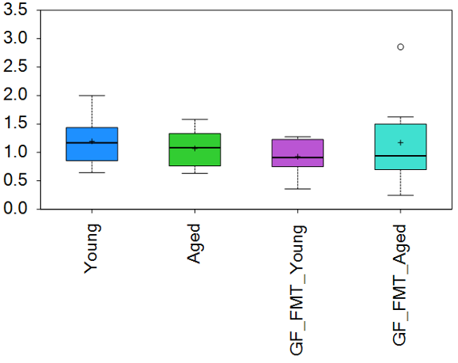
Data Display – Mouse Box Plots
Metabolite Name
Box Plot Legend
Scaled Intensity
Group

Slide 11
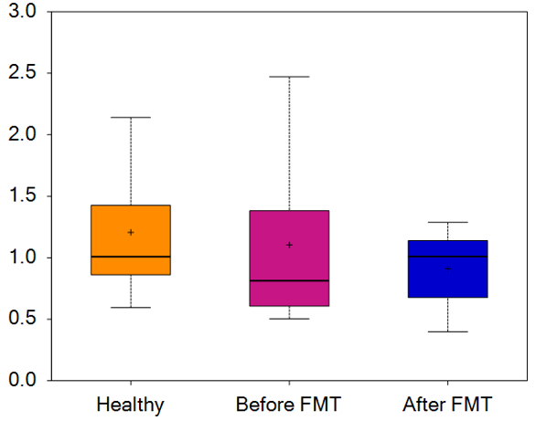
Data Display – Human Box Plots
Metabolite Name
Box Plot Legend
Scaled Intensity
Group

Slide 12
PCA (Mouse Study Arm)
Plasma
Cecal Content

Slide 13
PCA (Mouse Study Arm)
Plasma
Feces

